Slide 1



RESTAURANT
PROJECT
FOOD MENU EXPERIMENTATION

Slide 2

NULL HYPOTHESIS
Descriptive dish names do not influence food choice behavior

Slide 3





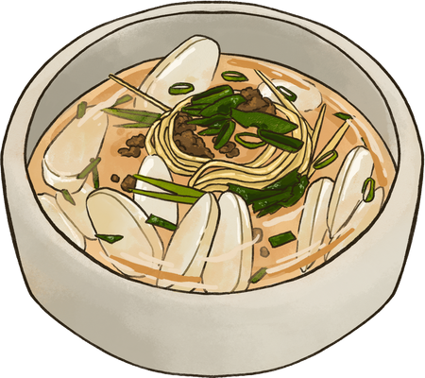
TOPIC OUTLINE
Data
EDA
ATE/CATE
Power Analysis
Business Application
Limitations
Conclusion

Slide 4

DATA
233 rows × 16 columns
119 - control, 114 - treatment
Age
Gender (Male/Female)
Hunger Level
Question 1 - Starter Menu
Question 2 - Salad Menu
Question 3 - Soup Menu
Question 4 - Sandwich
Question 5 - Açaí Bowl
Question 6 - Coffee
Question 7 - Attention Check
Question 8 - Pizza
Question 9 - Pasta
Question 10 - Noodles
Question 11 - Dessert
Treatment/Control

Slide 5
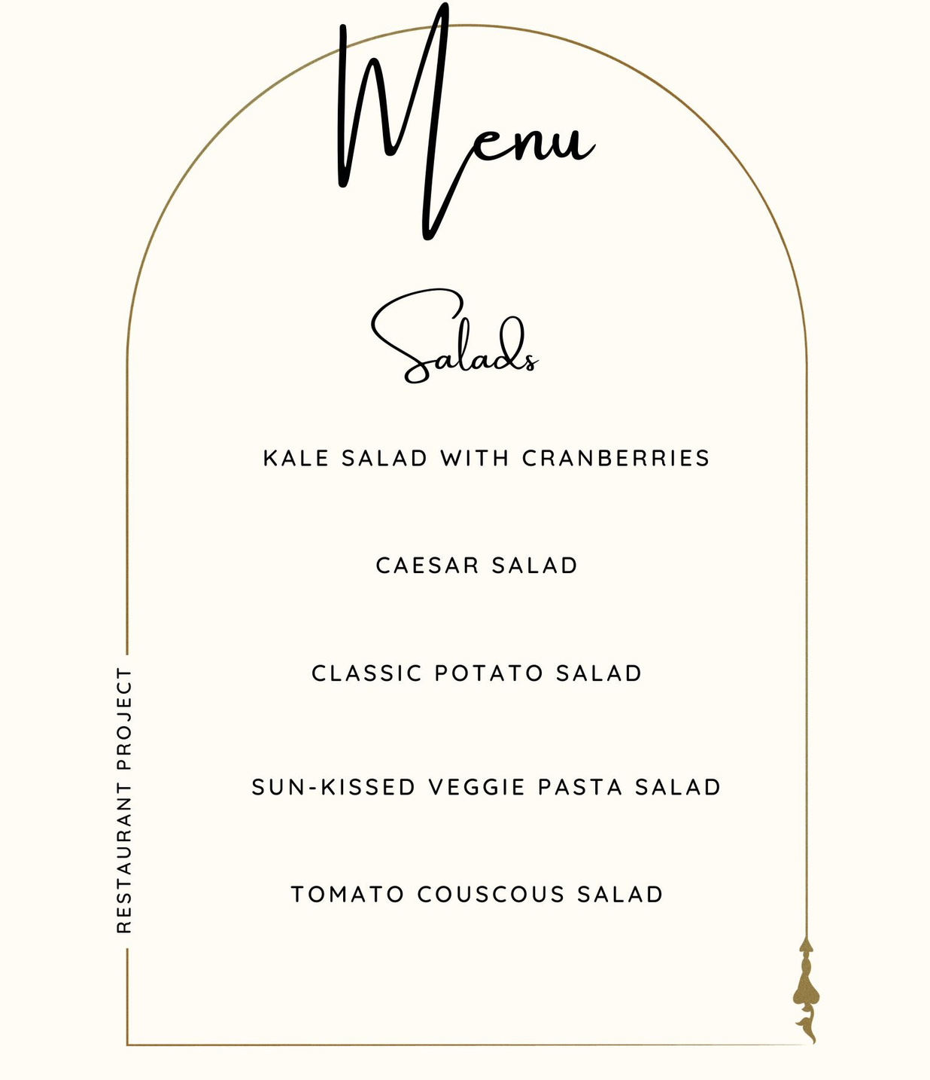
Survey
Demographic - We did not focus on any particular demographic. This survey was provided worldwide
Age Group - We had age groups ranging from as low as 18 to as high as 40+
Gender - We had similar range for both Male and Female
Hunger Level - We chose a covariate to understand how their hunger level affects their selection

Slide 6

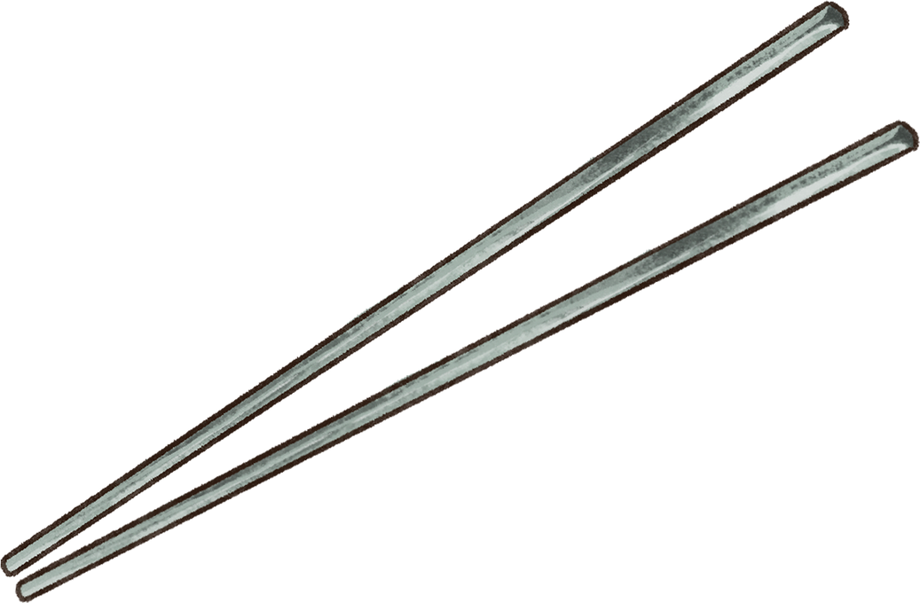

RANDOMIZATION CHECK
Z-statistic:
-0.775
P-value:
0.4380

Slide 7
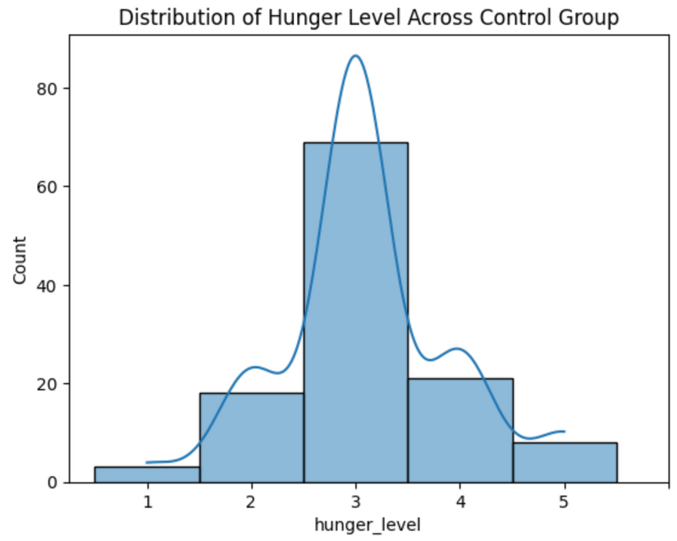
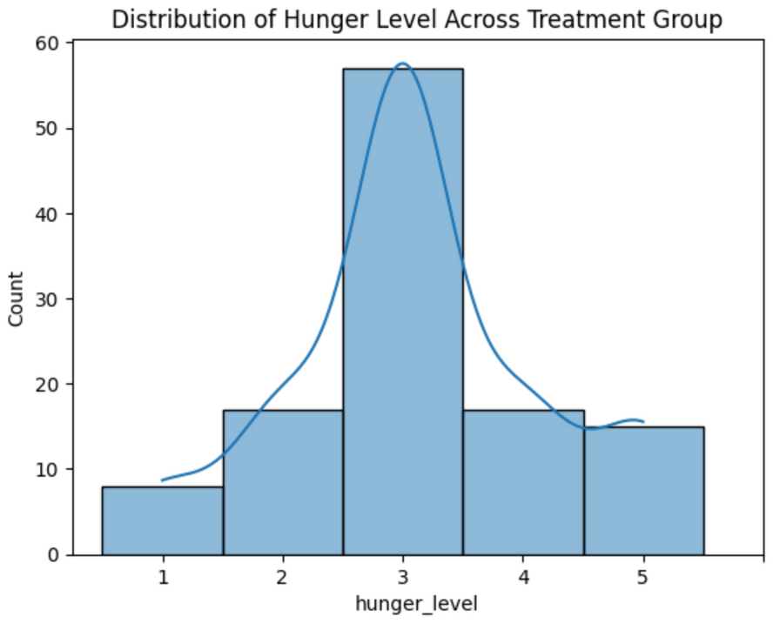
COVARIATE: HUNGER LEVEL

Slide 8
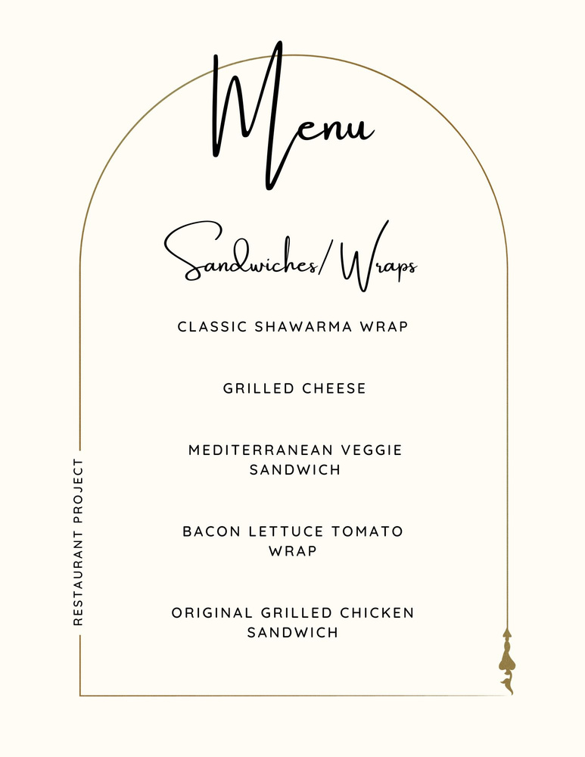
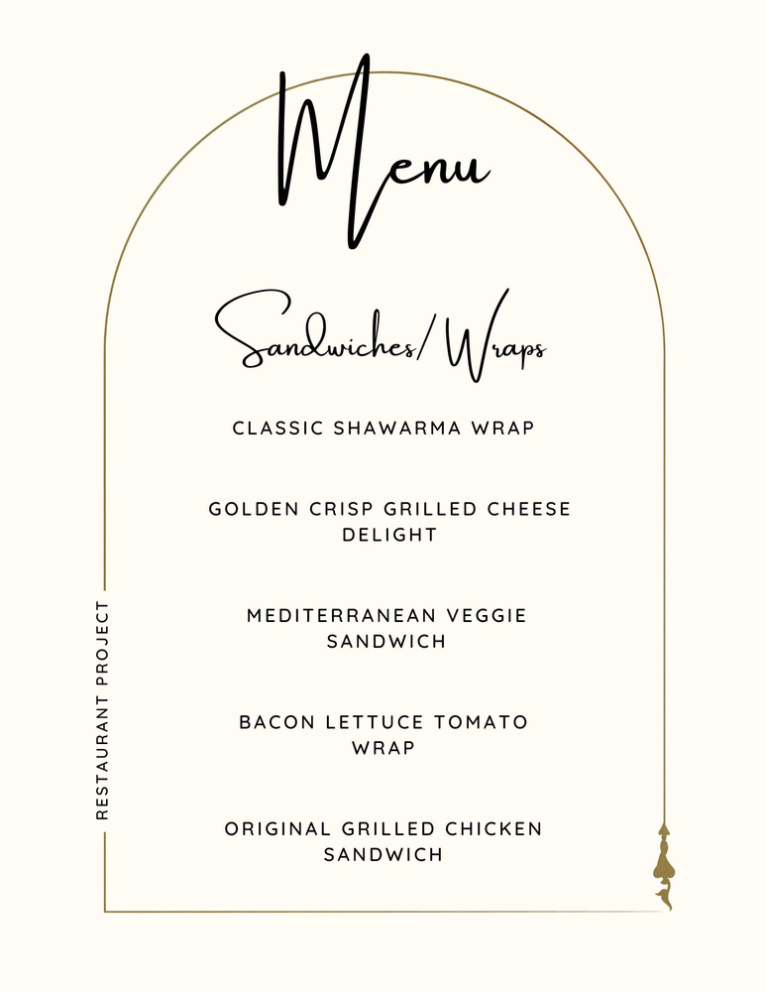
Treatment v/s Control : survey example

Slide 9
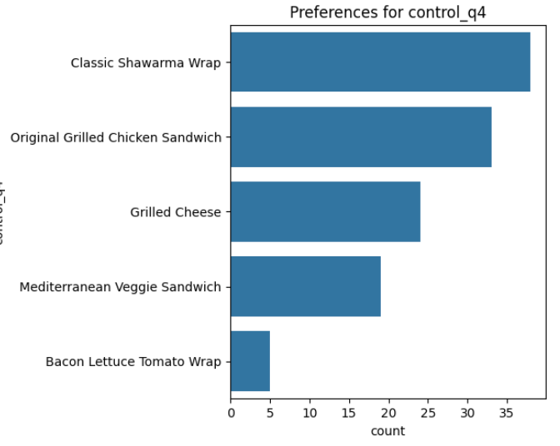
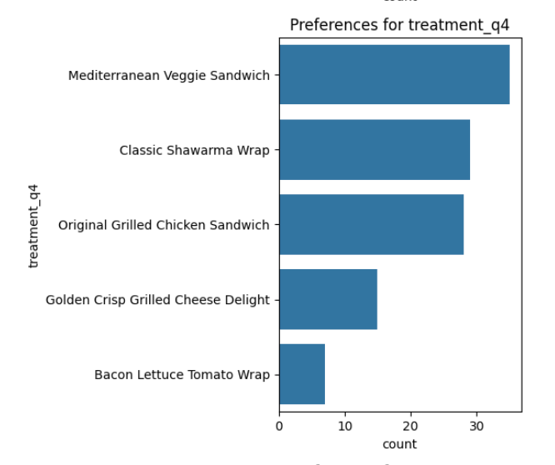
TREATMENT V/S CONTROL : SURVEY EXAMPLE RESULTS

Slide 10

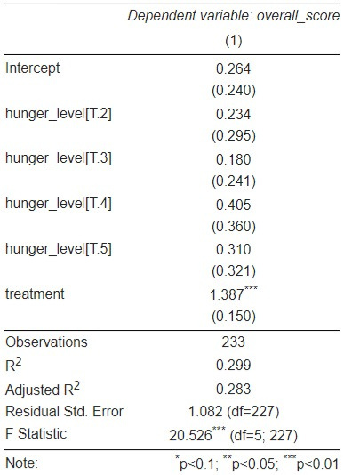

AVERAGE TREATMENT EFFECT

Slide 11
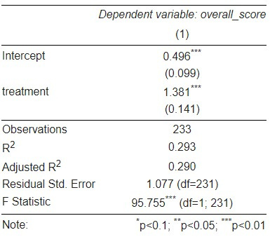
AVERAGE TREATMENT EFFECT
Looking at the control group, where the descriptive names were absent people would have chosen the right dishes 0.5 /10 times.
In the treatment Group when people were exposed to the descriptive names, they would choose that dish (1.381+0.496) 1.877/10 times.

Slide 12
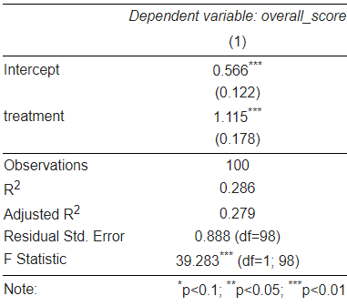
Conditional Average Treatment Effect
Condition: Age Group 18-23
Looking at the control group, where the descriptive names were absent people would have chosen the right dishes 0.566 /10 times.
In the treatment Group when people were exposed to the descriptive names, they would choose that dish (1.115+0.566) 1.681/10 of the times

Slide 13
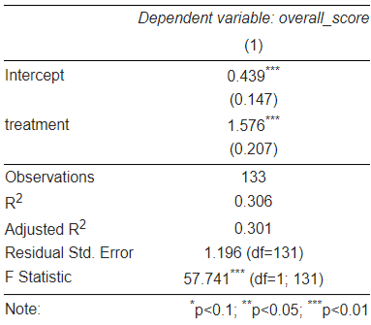
Conditional Average Treatment Effect
Condition: Age Group 24 and above
Looking at the control group, where the descriptive names were absent people would have chosen the right dishes 0.43 /10 times.
In the treatment Group when people were exposed to the descriptive names, they would choose that dish (1.576+0.439) 2.015/10 of the times

Slide 14
Power Analysis
Ex-Ante to find an effect size of 0.5:
power = 0.8
effect size = 0.5
alpha= 0.05
n = 63.7656
Ex-post Power analysis:
cohen’s d: 1.0795
power: 1

Slide 15
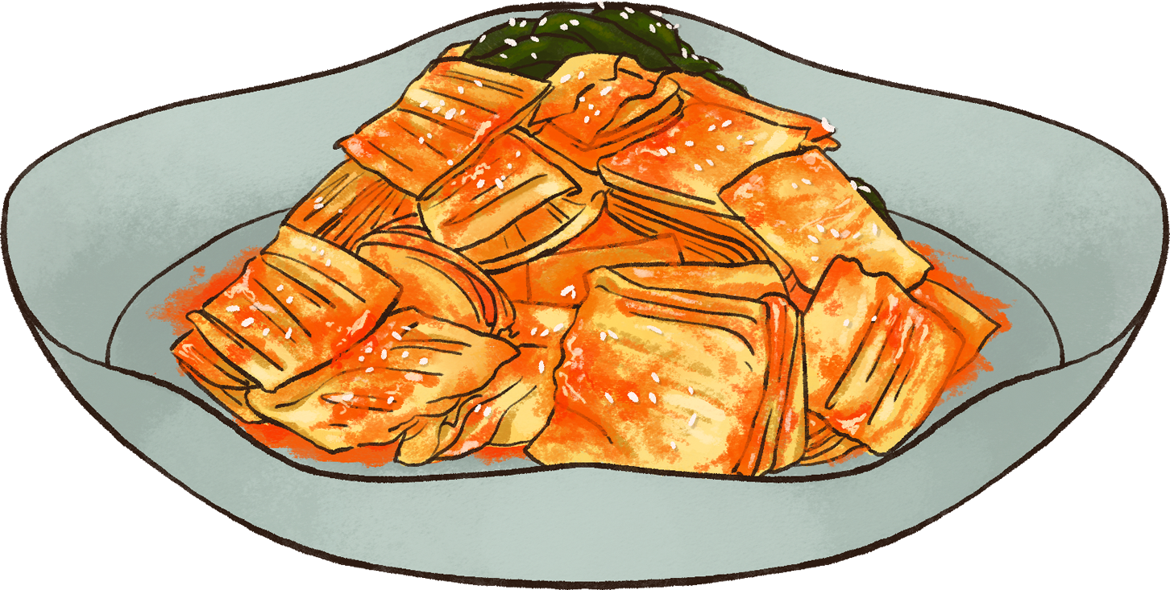
BUSINESS APPLICATIONS
Menu Expansion
Menu Promotion
Introducing new items with descriptive names can educate customers about the product and encourage them to try it.
Marketing campaigns highlighting dishes with enticing descriptive names to attract customers.
Brand Differentiation
Seasonal Specials
Stand out from competitors by using creative names to establish a unique restaurant identity.
Offer limited-time menu items with catchy names for seasonal events. eg. Tropical sunset smoothie bowl during the summers.

Slide 16

LIMITATIONS
Situational Factors
External factors such as time constraints or social influences could impact participants' decision-making during the experiment.
Time Constraint
Improved sample size and focusing on the different consumer backgrounds.
Measurement Variables
Including more variables like pricing, portion size, visual representation of the dish.
Attention-Check
Including other attention-check methods to evaluate the effectiveness of the survey.

Slide 17
CONCLUSION
Reject our null hypothesis: Descriptive dish names do not influence food choice behavior.
Incorporating limitations and different covariates.

Slide 18
THANK YOU!

